Slide 1




Last Scanned: November 2023
Honestycar Security Intelligence Report
An external perspective, emulating the tactics and techniques employed by real-world attackers using passive reconnaissance to identify potential vulnerabilities that cybercriminals could exploit
Cybersecurity Executive Brief
Honestycar faces significant cybersecurity risks like improper input validation, weak ciphers, and insecure file upload functionality and network vulnerabilities. These weaknesses pose significant risks to data integrity, confidentiality, and business operations.
Medium
Low
High
Your Risk Score
Industry Benchmark
Info
Critical
63
64
Riskometer
Cyberattack Entry Points Identified
The "Get Quote" page of Honestycar website lacks input validation, risking script-based attacks that could expose data, damage brand trust, and trigger compliance issues.
Honestycar website supports outdated TLS 1.0/1.1 protocols, exposing it to known attacks and putting encrypted data, compliance, and customer trust at risk.
The web application accepts SVG and GIF files with malicious content, risking code execution in users browsers, potentially leading to session hijacking and user data compromise.
Missing security headers in the Honestycar website increase exposure to cross-site scripting, clickjacking, and other web attacks, putting user data and session integrity at risk.

Slide 2
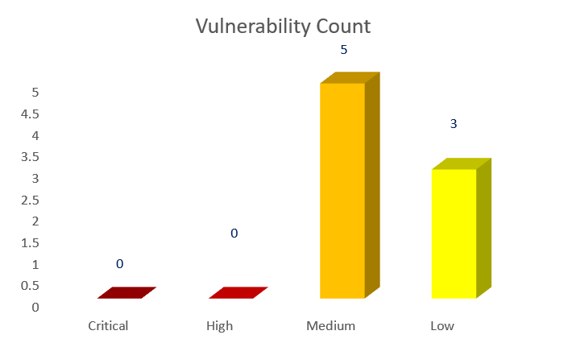



Vulnerability Summary
Vulnerability Summary
Vulnerability Summary
Vulnerability Summary
Vulnerability | Severity
Weak ciphers | Medium
Improper input validation | Medium
Missing file upload validation | Medium
Missing security Headers | Medium
Missing Cookie attributes-Http only, secure flag | Medium
Data exposure | Low
Weak Hashing Algorithm | Low
Vulnerable Bootstrap and jQuery version | Low
Threat Type | Risks
Data exposure | Usernames are exposed, enabling password attacks that risk unauthorized access, data breaches, and compliance violations.
Subdomain Takeover | Subdomains are misconfigured and vulnerable to takeover, allowing attackers to hijack them for phishing or malware, risking brand abuse and user compromise.
Open Port | Port 22 is exposed, making the server a target for SSH brute-force attacks, increasing the risk of unauthorized access and server compromise.
60+
What’s in it for you?
YASH Recommendations
Explore the most prevalent and impactful threats, techniques, and trends that we’ve observed.
Prioritize and categorize the threats based on their severity and impact on your business and invest your valuable time and resources on stuff that needs immediate attention.
Shape and inform your readiness, detection, and response to critical threats
Get a custom consultation from our cybersecurity experts and secure your IT landscape.
Why Learn More?
Assess & Manage
Security performance
Continuously Monitor
Critical Vendors
For more information write to us at cybersecurity@yash.com
Map to Global Cyber
Security Frameworks
(e.g. NIST & ISO/IEC 27001)
Disclaimer: All the information for the report has been obtained from publicly available sources. YASH technologies does not perform any unauthorized assessment that could impact your business
Maximise security posture with SOC/MDR/VMS/TRPM

